Slide 1
Foundations of Artificial Intelligence Unit –I
B.Tech. III-I AI &ML Minor course

Slide 2
Textbook:
1. Artificial Intelligence, Saroj Kaushik, 1st Edition, Cengage Learning
Reference Books:
Artificial Intelligence, Elaine Rich, Kevin Knight, Shivashankar B Nair,
3rd Edition, Tata McGraw Hill Education Private Limited., 2009
Artificial Intelligence- A modern Approach, 3rd Edition, Stuart Russel,
Peter Norvig, Pearson Education

Slide 3
Introduction to Artificial Intelligence (AI)
Definitions of AI:
“The science and engineering of making intelligent machines” (1956,
John McCarthy)
“The study of how to make computers do things at which, at the moment , people are better” (1991,Rich and Knight)
“The branch of computer science that is concerned with the
automation of intelligent behavior” ( 1993, Luger and Stubblefield)

Slide 4
Introduction to Artificial Intelligence (AI)
Definitions of AI:
The theory and development of computer systems to perform tasks normally requiring human intelligence, such as visual perception, speech recognition, decision-making, and translation between languages. (English Oxford Living Dictionary)
A branch of computer science dealing with the simulation of intelligent behavior in computers (Merriam-Webster Dictionary)

Slide 5
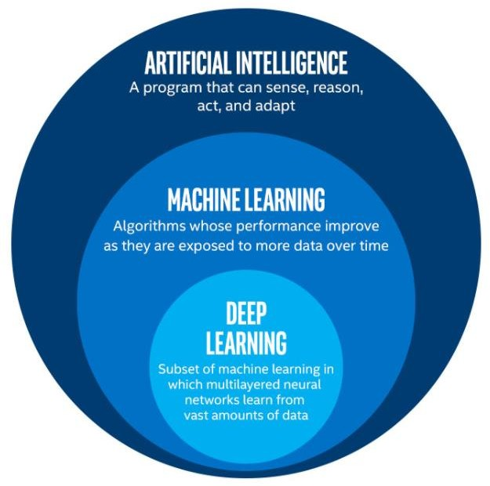
AI vs. ML vs. DL

Slide 6
History of AI
Initially Artificial Intelligence was called as Machine Intelligence
John McCarthy organized a conference on Machine Intelligence in
1956 and coined the term “Artificial Intelligence”
He was an American computer scientist, pioneer and inventor
He is known as the father of Artificial Intelligence (AI)
In 1957, first version of a new program named as General Problem Solver(GPS) was developed by Newell and Simon
GPS was capable of solving to some extent the problems requiring
common sense.

Slide 7
History of AI
In 1958, John McCarthy developed LISt Processing Language (LISP)
LISP was adopted as the language of choice by most AI developers
Marvin Minsky of MIT demonstrated that computer programs could solve spatial and logic problems when confined to a specific domain
In 1960, a program named STUDENT was developed which could solve algebra story problems.

Slide 8
History of AI
Fuzzy Set and Logic was developed by L Zadeh in 1960 that had the unique ability to make decisions under uncertain conditions
Neural Networks were considered as possible ways of achieving
Artificial Intelligence
MACLISP language was used to develop a program called SHRDLU
by Terry Winograd at MIT
PROLOG language was proposed by R Kowalski, Imperial College, London

Slide 9
History of AI
In 1970, Expert Systems were developed to predict the probability
of a solution under a set of conditions
An expert system is a program that uses logical rules that are derived from the knowledge of experts to answer the question or solve problems about a specific domain of knowledge
Expert Systems were used for
forecasting the stock market
aiding doctors with ability to diagnose disease
instructing miners to promising mineral locations

Slide 10
Categories of AI System
Systems that think like humans
Systems that act like humans
Systems that think rationally
Systems that act rationally

Slide 11
Systems that think like humans
Most of the time it is a black box where we are not clear about our thought process.
One has to know functioning of brain and its mechanism for possessing information.
It is an area of cognitive science.
The stimuli are converted into mental representation.
Cognitive processes manipulate representation to build new representations that are used to generate actions.
Neural network is a computing model for processing information similar to brain.
Systems that act like humans
The overall behaviour of the system should be human like.
It could be achieved by observation.

Slide 12
Systems that think rationally
Such systems rely on logic rather than human to measure correctness.
For thinking rationally or logically, logic formulas and theories are used for synthesizing outcomes.
For example,
given John is a human and all humans are mortal then one can conclude logically that John is mortal
Not all intelligent behavior are mediated by logical deliberation.
Systems that act rationally
Rational behavior means doing right thing.
Even if method is illogical, the observed behavior must be rational.

Slide 13
Intelligent Systems
AI is the study of making computers do things intelligently.
AI is a combination of computer science, physiology and
philosophy
AI programs must have capability and characteristics of intelligence such as learning, reasoning, inferencing, perceiving and comprehending information
Intelligent System (IS) incorporates intelligence machines.
can be defined as the system that
into applications being handled by

Slide 14
Intelligent Systems
There are two views of AI goals:
AI is about duplicating what the human brain does (Cognitive science)
AI is about duplicating what the human brain should do, that is, doing things logically or rationally

Slide 15
Intelligent Systems
There a lot of challenges in building systems that mimic the behavior of the human brain which is made up of a billion of neurons
In order to classify systems as intelligent , it is necessary to define
intelligence
The earliest best method to gauge the intelligence of a system was
the Turing test proposed by Alan Turing in 1950
He said that a system is called intelligent if it has an ability to pass the Turing test.

Slide 16
Intelligent Systems
Turing test is informally defined as :
A system is said to have passed the Turing test, if a human questioner is unable to determine from repeated questions of
any kind, whether he or she is talking to another person or to a machine/system
The very first intelligent system named Eliza passed the Turing
test which was written by Joseph Weizenbaum during 1964 to
1966 at MIT

Slide 17
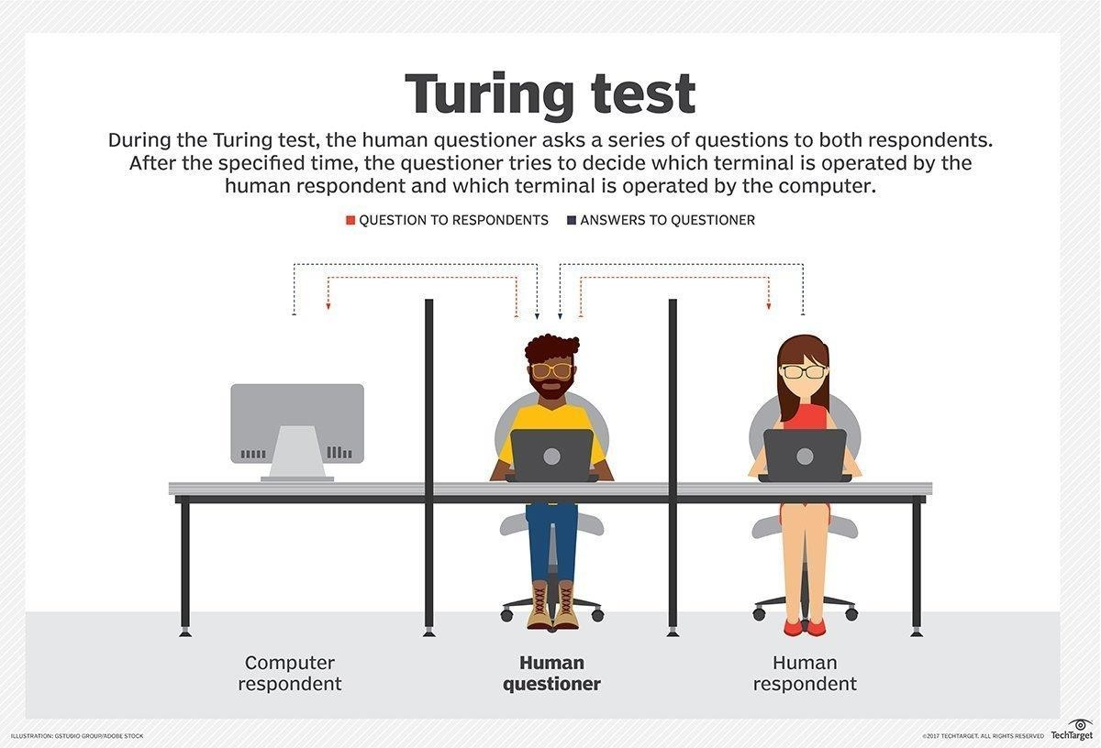

Slide 18
Eliza: Intelligent System
Eliza was a program designed to imitate a therapist
It conversed with the user in English.
It was able to converse about any subject using information
stored in data banks
It picked up speech patterns from user’s questions and provided responses using those patterns
Sample dialogue between Eliza and a teenage girl is as
follows:

Slide 19
Eliza: Intelligent System
Main characteristics of Eliza:
Simulation of Intelligence: Simulated
intelligent behavior quite
effectively by recognizing key words and phrases
Quality of response: Success depended on the fact that the user had a
restricted idea of expected response from the system
Coherence: Initial versions were based entirely on the current input and no context information was used. Intelligence depended on the coherence(focus) of the conversation as judged by the user
Semantics: No semantic representation of the content of user input or reply, it does not have intelligence of understanding of what we are saying. It imitates human conversation style, hence it passed Turing test

Slide 20
Categorization of Intelligent Systems
Four categories of Intelligent Systems are:
System that thinks like humans: Requires cognitive modelling approaches, functioning of the brain should be known
System that acts like humans: Overall behavior should be human-like
which could be achieved by observation
System that thinks rationally: Relies on logic than humans to measure
correctness
System that acts rationally: Doing the right thing, even though the
method could be illogical

Slide 21
Intelligence
Intelligence can be defined as that property of mind which encompasses many
related mental abilities such as:
Reason and draw meaningful conclusions
Plan sequences of actions to complete a goal
Solve problems
Think abstractly
Comprehend ideas and help computers to communicate in Languages
Store knowledge provided before or during interrogation
Learn new ideas from environment and new circumstances
Offer advice based on rules and situations
Learn new concepts and tasks that require high levels of intelligence
Natural

Slide 22
Components of AI Program
Any AI program should have :
Knowledge base- AI programs should be learning in nature and update their knowledge accordingly . Knowledge base generally consists of facts and rules and has the following characteristics:
It is voluminous in nature and requires proper structuring
It may be incomplete and imprecise
It may be dynamic and keep on changing
Control Strategy- It determines which rule to be applied
Inference Mechanism- It requires search through knowledge base and derives
new knowledge using the existing knowledge with the help of inference rules

Slide 23
Foundations of AI
As AI is interdisciplinary in nature, foundation of AI is in various fields
such as:
Mathematics
Neuroscience
Control Theory
Linguistics

Slide 24
Foundations - Mathematics
More formal logical methods
Boolean logic
Fuzzy logic
Uncertainty
The basis for most modern approaches to handle uncertainty in AI applications can be handled by
Probability theory
Modal and Temporal logics

Slide 25
Foundations - Neuroscience
How do the brain works?
Early studies (1824) relied on injured and abnormal people to understand what parts of brain work
More recent studies use accurate sensors to correlate brain activity to human thought
By monitoring individual neurons, monkeys can now control a computer mouse using thought alone
Moore’s law states that computers will have as many gates as humans have neurons in 2020
How close are we to have a mechanical brain?
Parallel computation, remapping, interconnections,….

Slide 26
Foundations – Control Theory
Machines can modify their behavior in response to the environment (sense/action loop)
Water-flow regulator, steam engine governor, thermostat
The theory of stable feedback systems (1894)
Build systems that transition from initial state to goal state with minimum energy
In 1950, control theory could only describe linear systems and AI largely rose as a response to this shortcoming

Slide 27
Foundations - Linguistics
Speech demonstrates so much of human intelligence
Analysis of human language reveals thought taking place in ways not understood in other settings
Children can create sentences they have never heard before
Language and thought are believed to be tightly intertwined

Slide 28
Sub-areas of AI
Sub areas of AI are:
Knowledge representation
Theorem proving
Game playing
Sense reasoning dealing with uncertainty and decision making
Learning models, inference techniques, pattern recognition, search and matching etc.
Logic (fuzzy, temporal, modal) in AI
Planning and scheduling
Natural language understanding
Computer vision
Understanding spoken utterances
Intelligent tutoring systems
Robotics
Machine translation systems
Expert problem solving
Neural Networks, AI tools etc

Slide 29
Applications of AI
AI has applications in almost all areas of real life applications :
Business : financial strategies, give advice
Engineering: check design, offer suggestions to create new product, expert systems for all engineering applications
Manufacturing: assembly, inspection, and maintenance
Medicine: monitoring, diagnosing and prescribing
Education: teaching

Slide 30
Applications of AI
Fraud detection : With the increase in the number of transactions
happening across the globe, the threat of financial fraud has increased too. AI based software can be used to monitor and detect any deviations from the normal pattern in transactions

Slide 31
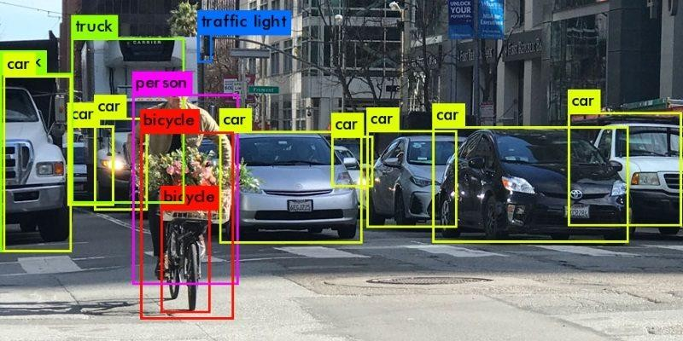
Applications of AI
Object Identification – For Self-driving cars

Slide 32
Applications of AI
Space shuttle scheduling- Automated planning and scheduling of
space shuttles
Information retrieval -Retrieve documents with information that is
relevant to user’s information need and helps the user complete a task , for eg. any search engine

Slide 33
Applications of AI in transportation
1 : Google’s AI-Powered Predictions
Using anonymized location data from smart phones, Google Maps (Maps) can analyze the speed of movement of traffic at any given time. And, with its acquisition of crowdsourced traffic app Waze in 2013, Maps can more easily incorporate user-reported traffic incidents like construction and accidents. Access to vast amounts of data being fed to its proprietary algorithms means Maps can reduce commutes by suggesting the fastest routes to and from work.
Waze is a community-driven GPS and navigational app that
guides you through the shortest route possible while driving.
Source : https://emerj.com/ai-sector-overviews/everyday-examples-of-ai/

Slide 34
Applications of AI in transportation
Waze helps riders and drivers get where they’re going—faster, smoother, safer, and happier—while working to beat traffic. User knows what is ahead with real- time help from other drivers.

Slide 35
Applications of AI in transportation
2 : Ridesharing Apps Like Uber and Lyft
Uber uses Machine Learning (sub-area of AI) to predict rider demand to ensure that “surge pricing”(short periods of sharp price increases to decrease rider demand and increase driver supply) will no longer be necessary. Uber uses machine learning for ETAs (Estimated Time of Arrival) for rides, estimated meal delivery times on UberEATS, computing optimal pickup locations, as well as for fraud detection

Slide 36
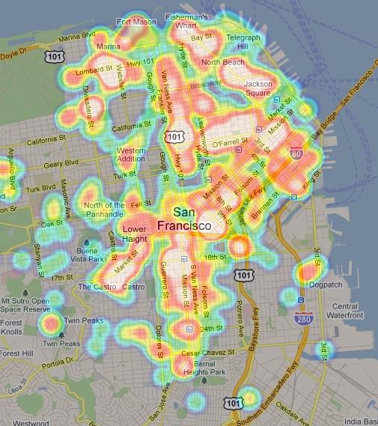
Applications of AI in transportation
Uber Heat Map

Slide 37
Applications of AI in transportation
3 : Commercial Flights Use an AI Autopilot
AI autopilots in commercial airlines is a surprisingly early use of AI technology that dates as far back as 1914. The New York Times reports that the average flight of a Boeing plane involves only seven minutes of human-steered flight, which is typically reserved only for takeoff and landing.

Slide 38
Applications of AI in transportation
In the future, AI will shorten your commute even further via self- driving cars that result in up to 90% fewer accidents, more efficient ride sharing to reduce the number of cars on the road by up to 75%, and smart traffic lights that reduce wait times by 40% and overall travel time by 26% in a pilot study.

Slide 39
Applications of AI in Email
: Spam Filters
Spam filters must continuously learn from a variety of signals, such as the words in the message, message metadata (where it’s sent from, who
sent it, etc.). Through the use of machine learning algorithms, Gmail successfully filters 99.9% of spam
: Smart Email Categorization
Gmail uses Smart Email Categorization approach to categorize your emails into primary, social, and promotion inboxes, as well as labeling emails as important

Slide 40
Applications of AI in Grading and Assessment
1 : Plagiarism Checkers
Many researchers and college students use Turnitin, a popular tool used by instructors to analyze students’ writing for plagiarism. Historically, plagiarism detection for regular text (essays, books, etc.) relies on a having a
massive database of reference materials to compare to the student text;
however, Machine Learning can help detect the plagiarizing of sources that are not located within the database, such as sources in foreign languages or older sources that have not been digitized.

Slide 41
Applications of AI in Grading and Assessment
2 : Robo-readers
Essay grading is very labor intensive, which has encouraged researchers and companies to build essay-grading AIs. The Graduate Record Exam (GRE), the primary test used for graduate school, grades essays using one human reader and one robo-reader called e-Rater.

Slide 42
Applications of AI in Grading and Assessment
2 : Robo-readers
Essay grading is very labor intensive, which has encouraged researchers and companies to build essay-grading AIs. The Graduate Record Exam (GRE), the primary test used for graduate school, grades essays using one human reader and one robo-reader called e-Rater.

Slide 43
Applications of AI: Automotive Industry

Slide 44
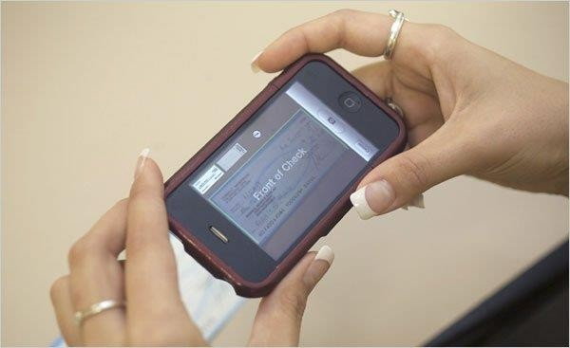
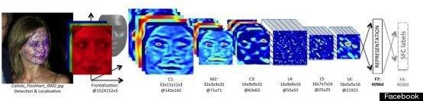
AI in Banking/Personal Finance
Mobile Cheque Deposit
AI in Social Networking
Facebook’s facial
recognition

Slide 45
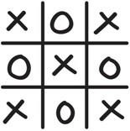
Tic-Tac-Toe Game Playing
Tic-Tac-Toe is a two-player game
Grid size is 3 X 3
One player marking X and another marking O
Player who succeeds in placing three respective marks in any horizontal, vertical or diagonal row wins the game.
Objective is to write a program using which the computer never
loses

Slide 46
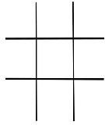
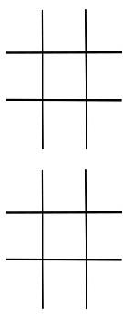

Tic-Tac-Toe Game Playing
:Winner
:Loser

Slide 47
Tic-Tac-Toe Game Playing : Approach 1
1 | 2 | 3
4 | 5 | 6
7 | 8 | 9
Tic –Tac- Toe Board
representing blank position
indicating X player move 2- indicating O player move

Slide 48
Tic-Tac-Toe Game Playing : Approach 1
This approach uses a program using a move table consisting of vector of
3⁹ (19683) elements
Index | Current Board Position 1 2 3 4 5 6 7 8 9 |  |  |  |  |  |  |  |  | New Board Position 1 2 3 4 5 6 7 8 9
0 | 0 | 0 | 0 | 0 | 0 | 0 | 0 | 0 | 0 | 0 | 0 | 0 | 0 | 1 | 0 | 0 | 0 | 0
1 | 0 | 0 | 0 | 0 | 0 | 0 | 0 | 0 | 1 | 0 | 2 | 0 | 0 | 0 | 0 | 0 | 0 | 1
2 | 0 | 0 | 0 | 0 | 0 | 0 | 0 | 0 | 2 | 0 | 0 | 0 | 1 | 0 | 0 | 0 | 0 | 2
3 | 0 | 0 | 0 | 0 | 0 | 0 | 0 | 1 | 0 | 0 | 0 | 2 | 0 | 0 | 0 | 0 | 1 | 0
 | .
 | .
 | .
 | .
 | .
 | .
 | .
 | .
Table 1: Move Table

Slide 49
Tic-Tac-Toe Game Playing : Approach 1
1 0 | 2 0 | 3 0
4 0 | 5 0 | 6 0
7 0 | 8 0 | 9 0
1 0 | 2 0 | 3 0
4 0 | 5 1 | 6 0
7 0 | 8 0 | 9 0
Case 1
1 0 | 2 0 | 3 0
4 0 | 5 0 | 6 0
7 0 | 8 0 | 9 1
1 0 | 2 2 | 3 0
4 0 | 5 0 | 6 0
7 0 | 8 0 | 9 1
Case 2

Slide 50
Tic-Tac-Toe Game Playing : Approach 1
The entries of a Move table are carefully designed manually, in advance,
keeping in mind that the computer should never lose
All possible board positions are stored in Current Board Position column along with its corresponding next best possible board position in New Board Position Column.
Once the table is designed, the computer program has to simply do the
table lookup

Slide 51
Tic-Tac-Toe Game Playing : Approach 1
Algorithm:
View the vector (board) as a ternary number
Get an index by converting this vector to its corresponding decimal number
Get the vector from New Board Position stored at the index. The vector thus selected represents the way the board will look after the move that should be made
So set board position equal to that vector

Slide 52
Tic-Tac-Toe Game Playing : Approach 1
Advantage:
Efficient with respect to time
Disadvantages:
Lot of memory requirement to store the move table
To specify entries in move table manually, lot of effort is required
Creating move table is highly error prone as data to be entered is
highly voluminous
This approach cannot be extended to 3D tic-tac-toe, as 3²⁷ board positions are to be stored
This program is not intelligent at all as it does not meet any of AI requirements

Slide 53
Tic-Tac-Toe Game Playing : Approach 2
1 | 2 | 3
4 | 5 | 6
7 | 8 | 9
Tic –Tac- Toe Board
X - whoever plays first move (human / computer) O - whoever plays second move (computer/ human)
- represents blank position
- indicates X player move 5 - indicates O player move

Slide 54
Tic-Tac-Toe Game Playing : Approach 2
Three sub procedures are used:
Go(n) : Using this function, the computer can make a move in square n
Make_2 : This function helps the computer to make valid 2 move i.e. valid two in any row, column or diagonal
PossWin(P) : If player P can win in the next move then it returns the index(from 1 to 9) of the square that constitutes a winning move, otherwise it returns 0

Slide 55
Tic-Tac-Toe Game Playing : Approach 2
If PossWin(P) =0, then P cannot win. Find whether opponent can win.
If so then block it. This can be achieved as follows:
If (3*3*2 =18) then X player can win as there is one blank square in row, column or diagonal
If ( 5*5*2 =50) then O player can win

Slide 56
Tic-Tac-Toe Game Playing : Approach 2
If PossWin(P) =0, then P cannot win. Find whether opponent can win.
If so then block it. This can be achieved as follows:
If (3*3*2 =18) then X player can win as there is one blank square in row, column or diagonal
If ( 5*5*2 =50) then O player can win

Slide 57
( C plays X, H plays O)
1 move: Go(5) /Go(1)
3 move: If B[9] is blank, then Go(9) else {make 2} Go(3)
5 move: {By now both have played 2 moves} : If PossWin(X) then {X wins} Go(PossWin(X)) else if PossWin(O) {block O} then Go(PossWin(O)) else if B[7] is blank then Go(7) else Go(3)
7 & 9 moves: {By now human ( playing O) has played 3 chances} : If PossWin(X) then {X wins} Go(PossWin(X)) else {block O} if PossWin(O) then Go(PossWin(O)) else Go(Anywhere)
Table 2a: Rules for Nine moves [{}-Comments ]

Slide 58
( H plays X, C plays O)
2 move: If B[5] is blank, then Go(5) else Go(1)
4 move: {By now human ( playing X) has played 2 moves} : If PossWin(X) then {block X} Go(PossWin(X)) else {make 2} Go(Make_2)
6 move: {By now computer has played 2 moves} : If PossWin(O) then {O wins} Go(PossWin(O)) else if PossWin(X) {block X} then Go(PossWin(X)) else Go(Make_2)
8 move: {By now computer has played 3 chances} : If PossWin(O) then {O wins} Go(PossWin(O)) else {block X} if PossWin(X) then Go(PossWin(X)) else Go(Anywhere)
Table 2b : Rules for Nine moves [{}-Comments ]

Slide 59
Tic-Tac-Toe Game Playing : Approach 2
Advantages:
More memory efficient
Easier to understand as complete strategy has been determined
in advance
Disadvantages:
Not as efficient as first one with respect to time. Several conditions are checked before each move
Cannot generalize to 3-D Tic –Tac-Toe

Slide 60

Tic-Tac-Toe Game Playing : Approach 3
In this approach, we choose board position to be a magic square of order 3
The magic square of order n
consists of n² distinct numbers
8 | 1 | 6
3 | 5 | 7
4 | 9 | 2
Sum for each row, column,
diagonal must be n[(n²+1)/2]
Magic Square of order 3
i.e. 15 in this case

Slide 61
Tic-Tac-Toe Game Playing : Approach 3
In this approach, we maintain a list of the blocks played by
each player, each block is identified by its number
First few moves are fixed as in Approach 2

Slide 62
Tic-Tac-Toe Game Playing : Approach 3
Winning strategy for the computer is as follows:
Each pair of blocks a player owns is considered
Difference D between 15 and the sum of the two blocks is
computed
If D <0 or D >9, then these two blocks are not collinear and so can be ignored: otherwise if the block representing difference is blank (i.e. not in either list) then player can move in that block
This strategy will produce a possible win for a player

Slide 63
Tic-Tac-Toe Game Playing : Approach 3
Player X (Human)
Player O (Computer)
Initially both lists are empty

Slide 64
Tic-Tac-Toe Game Playing : Approach 3
Player X (Human)
8 | 1 | 4 | 2
Player O (Computer)
5 | 6 | 3
Status of both lists after Seventh Move

Slide 65
Tic-Tac-Toe Game Playing : Approach 3
Assume that human(H) is the first player(X), computer(C) is second player(O)
Turn 1 : Suppose H plays in the eighth block
Turn 2 : C plays in fifth block (fixed move, refer table 2b)
Turn 3 : H plays in first block
Turn 4 : C checks if H can win or not
Compute sum of blocks played by H
S = 8+1 = 9
Compute D =15-9 =6
The sixth block is a winning block for H and not there on either list. So C blocks it and plays in sixth block. The sixth block is recorded in the list of computer
Turn 5 : H plays in fourth block
[contd.]

Slide 66
Tic-Tac-Toe Game Playing : Approach 3
Turn 6 : C checks if C can win as follows:
Compute sum of blocks played by C
S = 5+6 = 11
Compute D =15-11 = 4; Discard this block as it already exists in X list
Now C checks whether H can win
Compute sum of pair of square from list of H which have not been used
earlier
S = 8 + 4 = 12
Compute D = 15-12 = 3
Block 3 is free, so C plays in this block. The third block is recorded in the list of computer .
[contd.]

Slide 67
Tic-Tac-Toe Game Playing : Approach 3
Turn 7 : If H plays in second or ninth block, the computer wins. Let us assume
that H plays in second block
Turn 8 : C checks if it can win as follows:
Compute sum of blocks played by C which has not been used earlier
S = 5+3 = 8
Compute D =15-8 = 7
Block 7 is free, so C plays in seventh block and wins the game
If H plays in seventh block at its Turn 7, then there is a draw.

Slide 68
Tic-Tac-Toe Game Playing : Approach 3
Advantages:
Can be extended to 3-D Tic –Tac-Toe
Can be extended to games complicated than Tic-Tac-Toe
Disadvantages:
Will require much more time than other two approaches as it must search a tree representing all possible move sequences before making each move

Slide 69
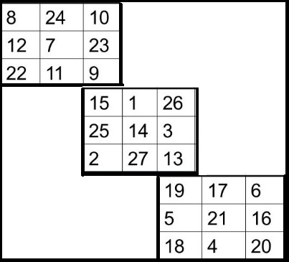
3D Tic-Tac-Toe
Magic Cube of order n has a magic constant equal to n[(n³+1)/2]
Here n=3, hence the magic
constant is 42
Sum of numbers on each row, each column on six outer surfaces of a cube, each row, each column and
two diagonals of middle grid and the four main space diagonals is equal to 42
Magic Cube

Slide 70
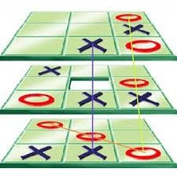
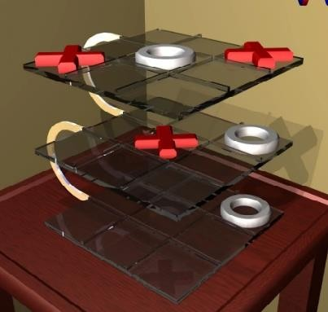
3D Tic-Tac-Toe Sample Board Layouts

Slide 71
Latest Perception of AI
Three typical components of AI Systems
THE WORLD
Perception Action
Reasoning

Slide 72
Current Trends in AI
Hard Computing algorithms, also termed as the conventional algorithms, follow mathematical methodologies strictly which make it inefficient to solve real world problems by taking more computation time.
The conventional algorithms require exact input data, use a precise
methodology and generate a precise output which make it a crisp system.
It fails when the input is not exact.
Examples of conventional algorithms are merge sort, quick sort, binary search, greedy algorithm, dynamic programming etc. which are deterministic.

Slide 73
Current Trends in AI
Soft Computing consists of numerous techniques that study the biological processes such as reasoning, genetic evolution, survival of the creatures and human nervous system. SC is an umbrella term to thoroughly study the simulation of reasoning, human nervous system and evolution in different fields:
Neural Networks
Fuzzy Logic
Evolutionary Algorithms
Swarm Intelligence etc.

Slide 74
Hard computing | Soft Computing
Conventional computing requires a precisely stated analytical model | It is tolerant of imprecision
Often requires a lot of computation time | Can solve some real world problems in reasonably less time
Not suitable for real world problems for which ideal model is not present | Suitable for real world problems
It requires full truth | Can work with partial truth
It is precise and accurate | Imprecise
High cost for solution | Low cost for solution
Hard Computing vs. Soft Computing

Slide 75
Current Trends in AI
Example: If we need to find out whether Bob is honest.
A hard computing algorithm would give an answer that is Yes or
No. (1 or 0 in binary)
Soft Computing technique (Fuzzy Logic) would give an answer with membership degree such as extremely honest (1), very honest (0.85), sometimes honest (0.35), extremely dishonest
(0.00), like a human.

Slide 76
Current Trends in AI- Soft Computing
Neural Network is a network of artificial neurons, inspired by biological network of neurons, that uses mathematical models as information processing units to discover patterns in data which is too complex to notice by humans.
Fuzzy Logic is a technique that understands the vagueness of a solution and presents the solution with a degree of vagueness which is practical to human decision. It is widely applied in several applications of Artificial Intelligence for reasoning.

Slide 77
Current Trends in AI- Soft Computing
Evolutionary algorithms are the algorithms that are based on the evolution of the species; in general they are based on the main evolutionary theory of Charles Darwin.
For eg. Genetic algorithms were developed mainly by emulating the nature and behaviour of biological chromosome.
Genetic algorithms are favoured for search problems which
require the identification of a global optimal solution

Slide 78
Current Trends in AI- Soft Computing
Swarm Intelligence (SI) is a type of AI based on the collective behaviour of decentralized, self-organized systems.
Insects like ants, bees, wasps and termites are able to solve complex problems emerging in their daily lives by mutual cooperation. This emergent behaviour of self organization by a group of insects is known as Swarm Intelligence.
In computational sense, a swarm has been defined as a set of agents which are liable to communicate directly or indirectly with each other and which collectively carry out a distributed problem solving.

Slide 79
Current Trends in AI
Expert system is a computer system that emulates the decision- making ability of a human expert. Expert systems are designed to solve complex problems by reasoning through bodies of knowledge, represented mainly as if-then rules rather than through conventional procedural code.
For eg. DENDRAL (Dendritic Algorithm): Expert system used for
chemical analysis to predict molecular structure

Slide 80
Current Trends in AI
Intelligent Agents: It refers to an autonomous entity which acts, directing its activity towards achieving goals, upon an environment using observation through sensors and consequent actuators. Intelligent agents may also learn or use knowledge to achieve their goals.
For eg. Alexa and Siri

